Slide 1
taskbar
Type the word three times.
taskbar

Slide 2
start button
Type the word three times.
start button

Slide 3
icon
Type the word three times.
icon

Slide 4
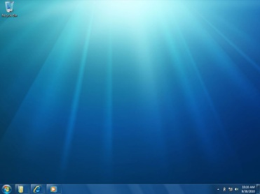
desktop
Type the word three times.
desktop

