Slide 1
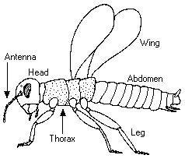
Insect Diagram

Slide 2
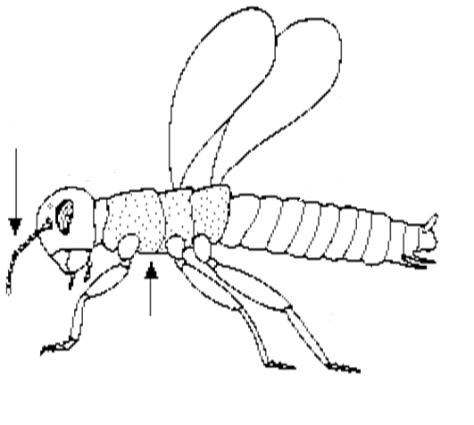
Use text boxes or word art to label the insect diagram.

