Slide 1
Life Cycle of a Butterfly
Mr. Slotman

Slide 2
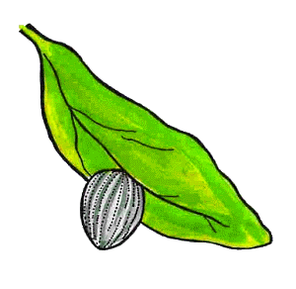
Egg

Slide 3
Larva

Slide 4
Butterfly Pupa

Slide 5
Adult Butterfly

